Slide 1
For the Long Haul: Supporting and Sustaining Leaders of Color
Webinar – April 4, 2024

Slide 2
Standard Webinar / Tech instructions
Social media
Use the Q&A
Etc.

Slide 3
Welcome / About BMP
Research, Resources, Relationships
Plug survey

Slide 4
Webinar Agenda
Summary Trends Across 2016, 2019, 2022
Leadership Aspiration is Declining
Negative Pushes Towards Leadership
Dilemmas of BIPOC Leadership
Panel: Supporting Pulls Towards Leadership
Discussion / Q&A

Slide 5
Poll: Get to know the audience?
Which best describes your role?
Aspiring Leader of Color
Aspiring White Leader
Current Leader of Color
Current White Leader
Capacity Builder / Intermediary of Color
White Capacity Builder / Intermediary
Funder
Other

Slide 6
Race to Lead Findings Over Time

Slide 7
Trends from Three Rounds of Surveys
Over the course of the three years – 2016, 2019 and 2022 – the Race to Lead surveys have garnered over 12,000 responses.
The composition of the survey sample has been remarkably similar over the years.
Many key findings from past surveys continue to resonate with the most recent data from 2022.

Slide 8
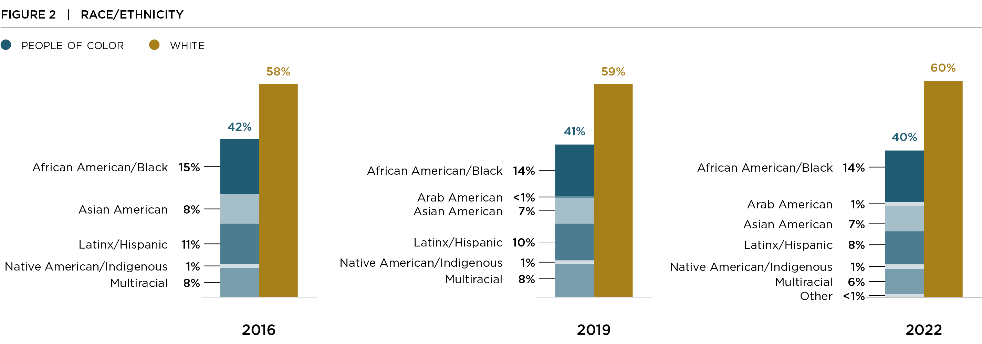
Race and Ethnicity

Slide 9
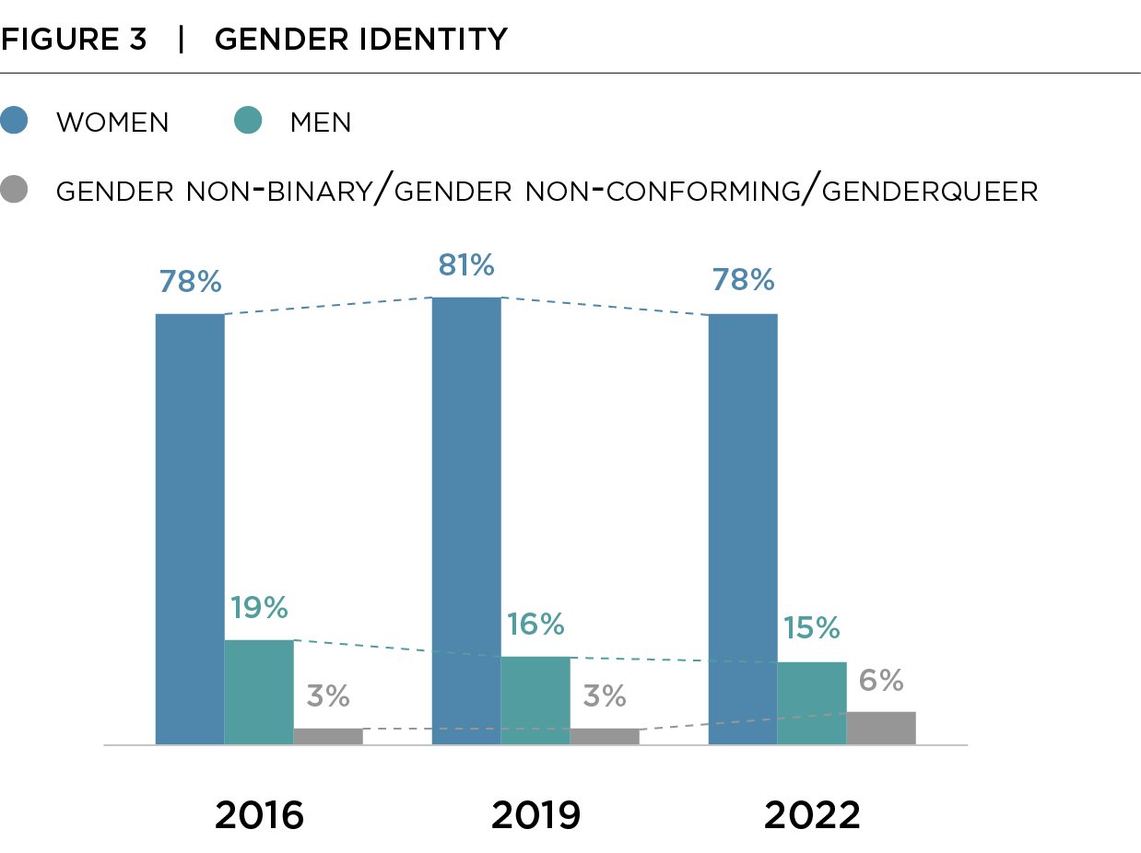
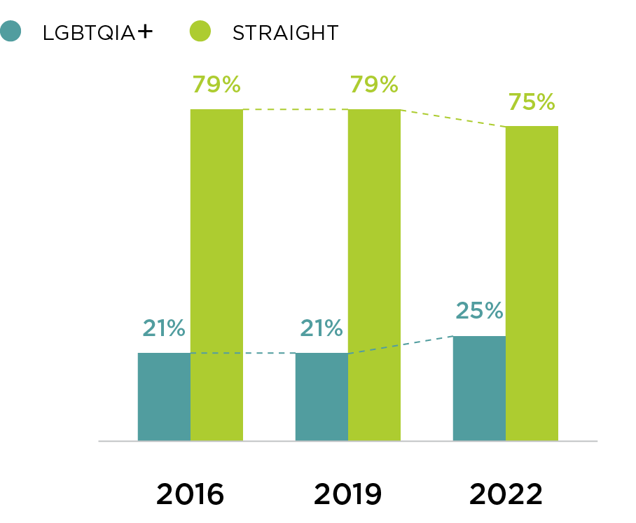
Gender and Sexuality

Slide 10
Role / Position
Notes:
Each year, another 5 to 6% of respondents indicated that they were in administrative assistant roles or some “other” role that wasn’t in our list.

Slide 11
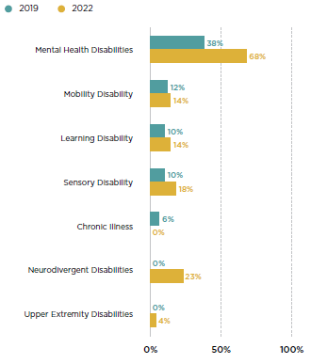
Disability (y/n) and Types of Disability

Slide 12
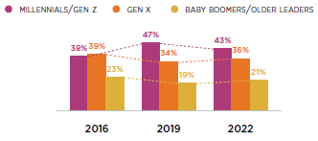
Generation and Position

Slide 13
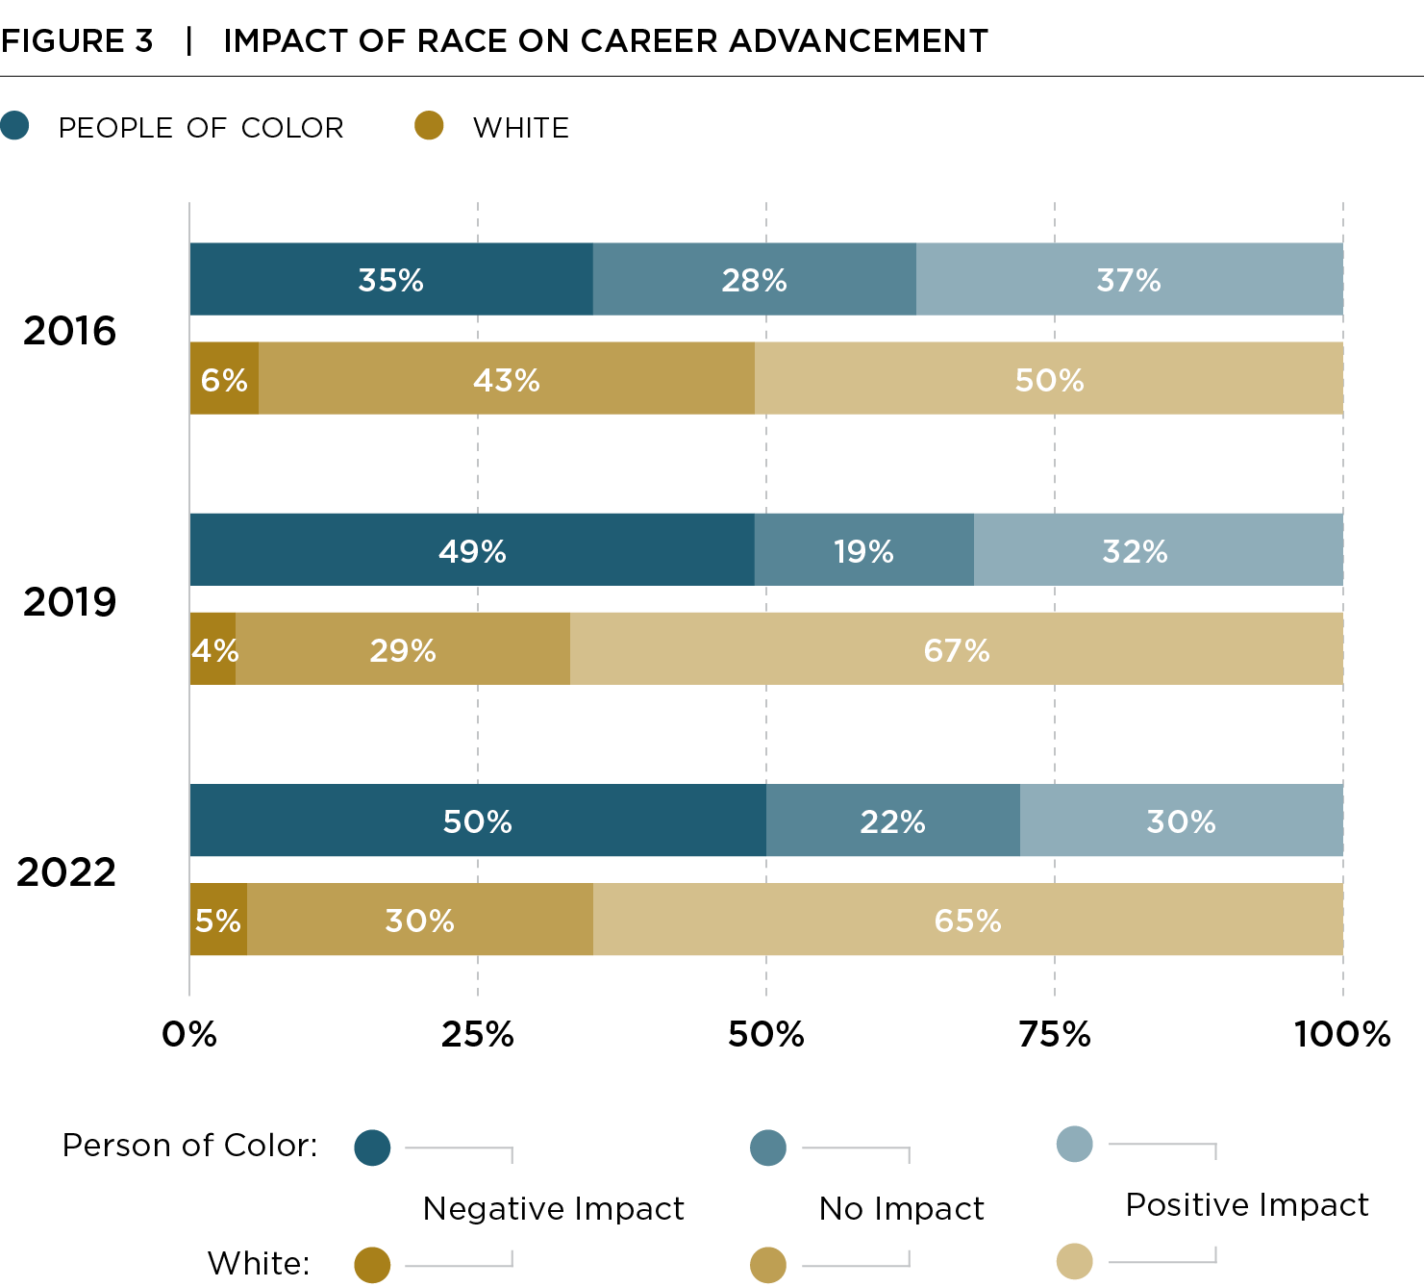
Impact of Race on Advancement
In 2016, a third of BIPOC respondents reported their race had a negative impact on their career advancement. That increased to half in 2019 and stayed at that level in 2022.
For white respondents, half reported that their race had a positive impact on their career advancement in 2016; then two-thirds in 2019 and 2022.

Slide 14
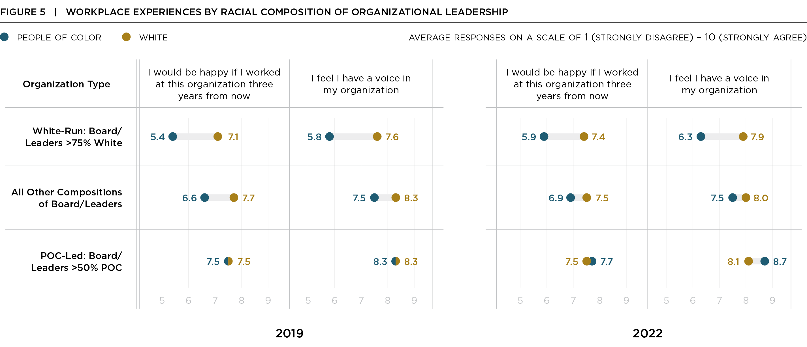
Workplace Experience
Respondents are happier in organizations with more diverse leadership
Racial gaps are narrower for respondents working in more diverse orgs.

Slide 15
The Push and Pull Key Findings
Notable decline in the aspiration to lead.
BIPOC respondents interested in leading appear “pushed” towards leadership to correct negative experiences.
BIPOC EDs/CEOs continue to report less support from boards and staff, and cite burnout as their top reason for leaving leadership positions.

Slide 16
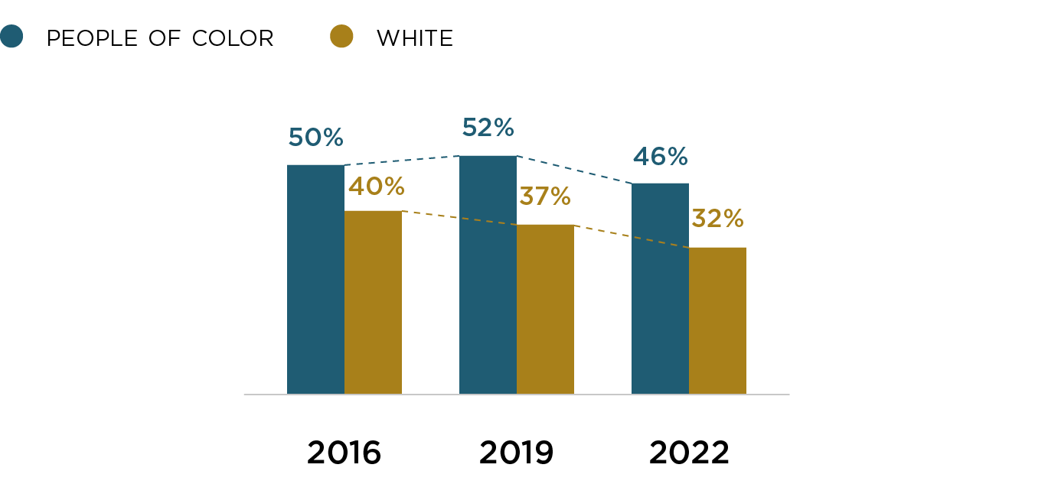
Declining Aspiration to Lead
Notes:
Figure shows % of respondents who are NOT and ED who said they were interested in taking on a top leadership role in a nonprofit organization.

Slide 17
Growing Opposition to Leadership
Notes:
What stands out here is the growing intensity in respondents saying they are NOT interested in taking on a top leadership role; There are always some respondents who respond maybe, but this is the clear No’s

Slide 18
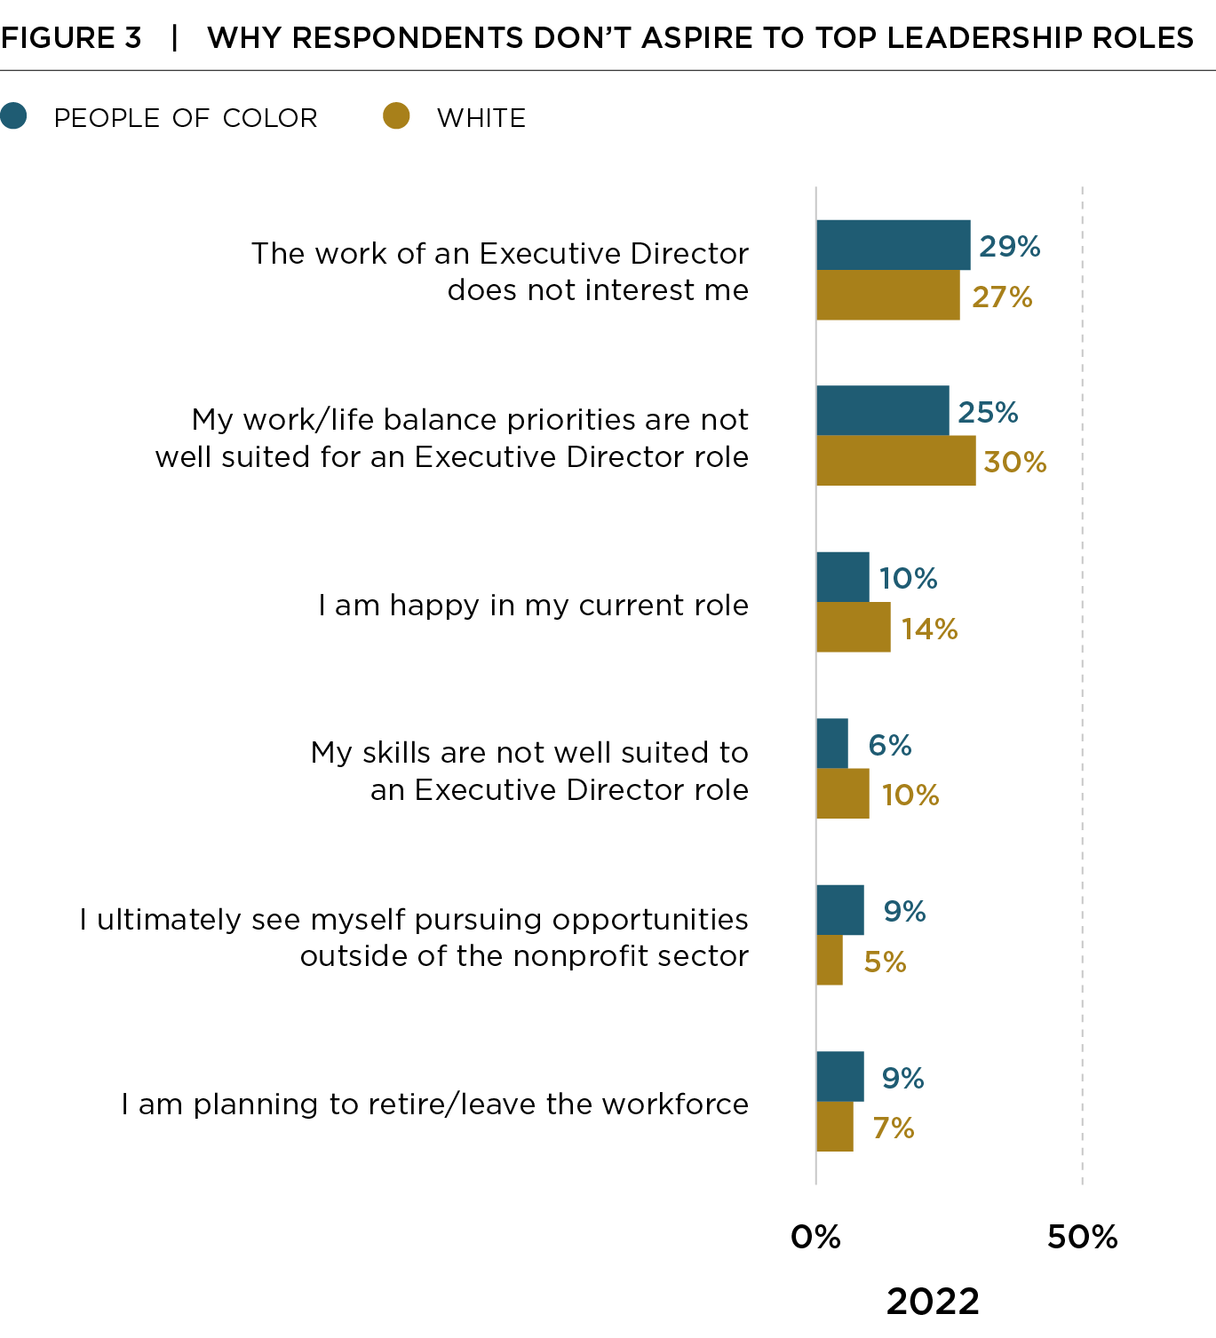
Reasons People Do NOT Aspire

Slide 19
Aspiration Increases If Report Challenges
Notes:
Emphasize that what we are showing here and on the next slide is that the aspiration to lead is much higher (18 pp) among respondents of color who reported that they struggled with inadequate salaries compared with respondents who didn’t face that challenge. The next slide shows that same pattern repeats for several other common challenges.

Slide 20
Aspiration Increases If Report Challenges

Slide 21
Aspiration Less Affected by Supports/Training

Slide 22
Aspiration Less Affected by Supports/Training
Notes:
Emphasize that what we are showing here and on the next slide is that the aspiration to lead is only somewhat higher (3 pp) among respondents of color who reported that they received training on staff management and supervision compared with respondents who didn’t get that kind of training. The next slide shows that there is no clear / consistent pattern for several other types of training and/or supports that we think of as being important to developing leadership in the sector. So this data really raises questions about leadership development strategies in the sector and whether we know what can actually develop future leaders.

Slide 23
Aspiration Less Affected by Supports/Training

Slide 24
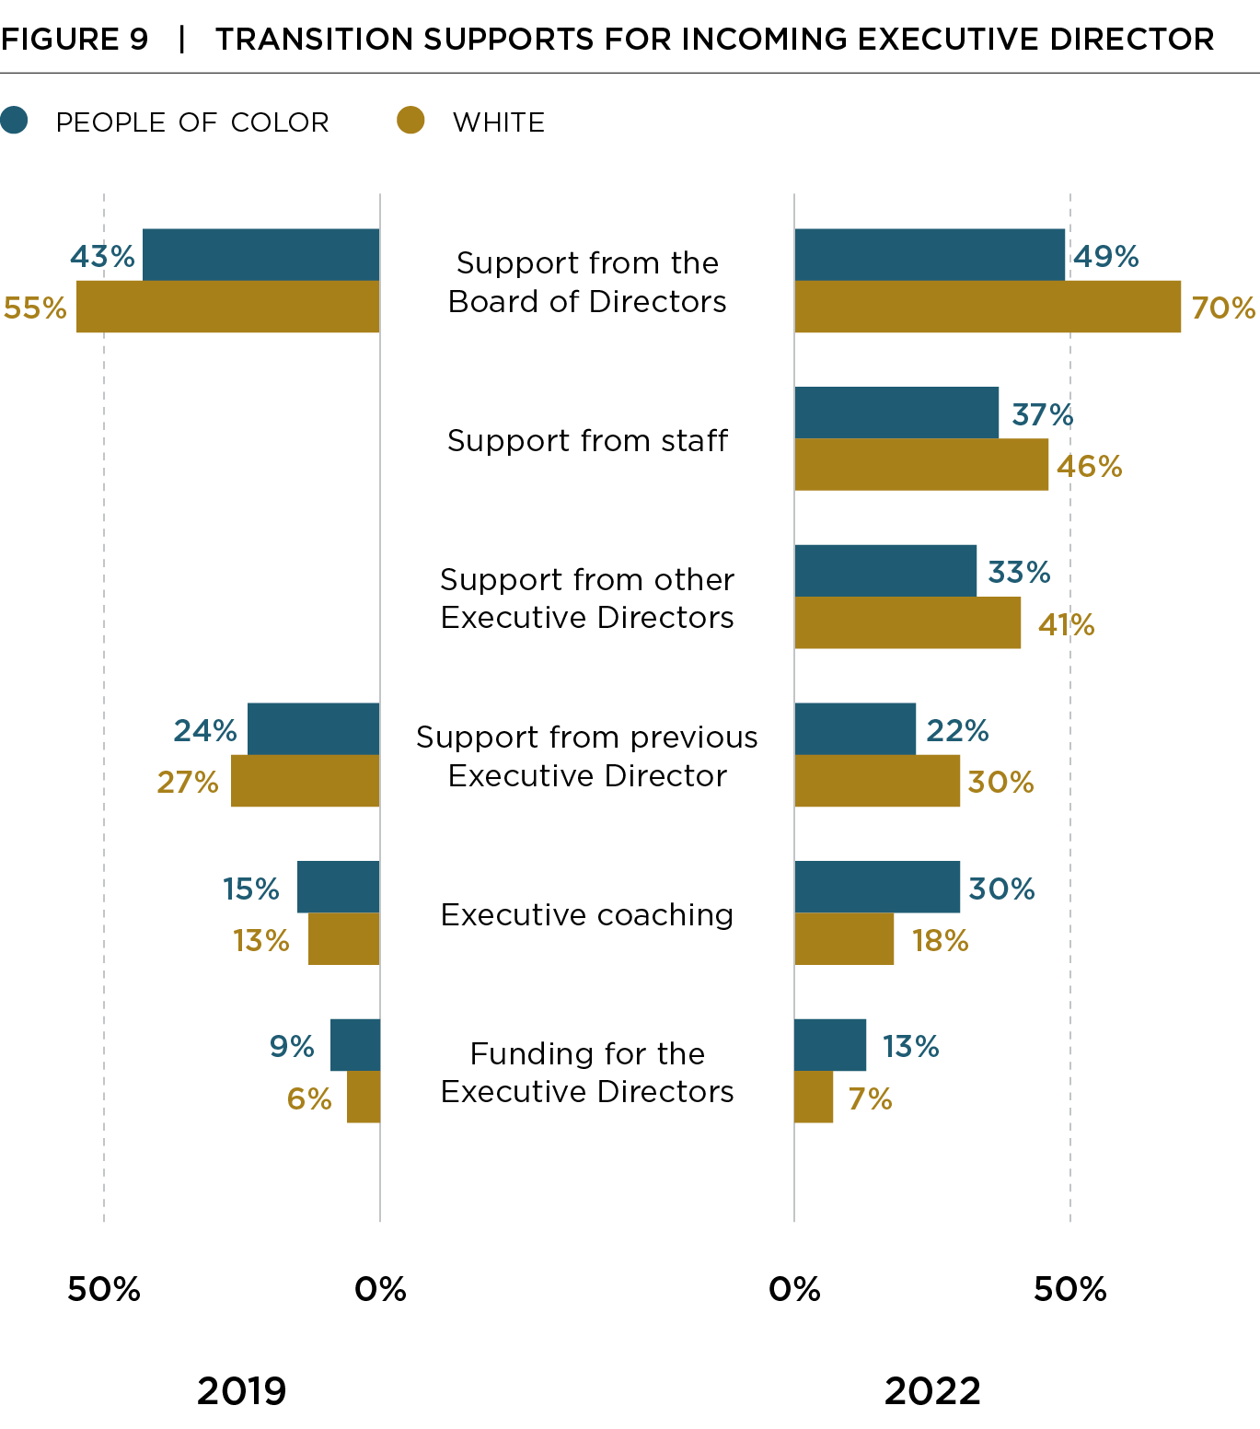
BIPOC EDs Report Less Transition Supports

Slide 25
Gaps in ED/CEO Experience Persist

Slide 26
Burnout is Top Reason for Transitions

Slide 27
Finding Leadership Pulls

Slide 28
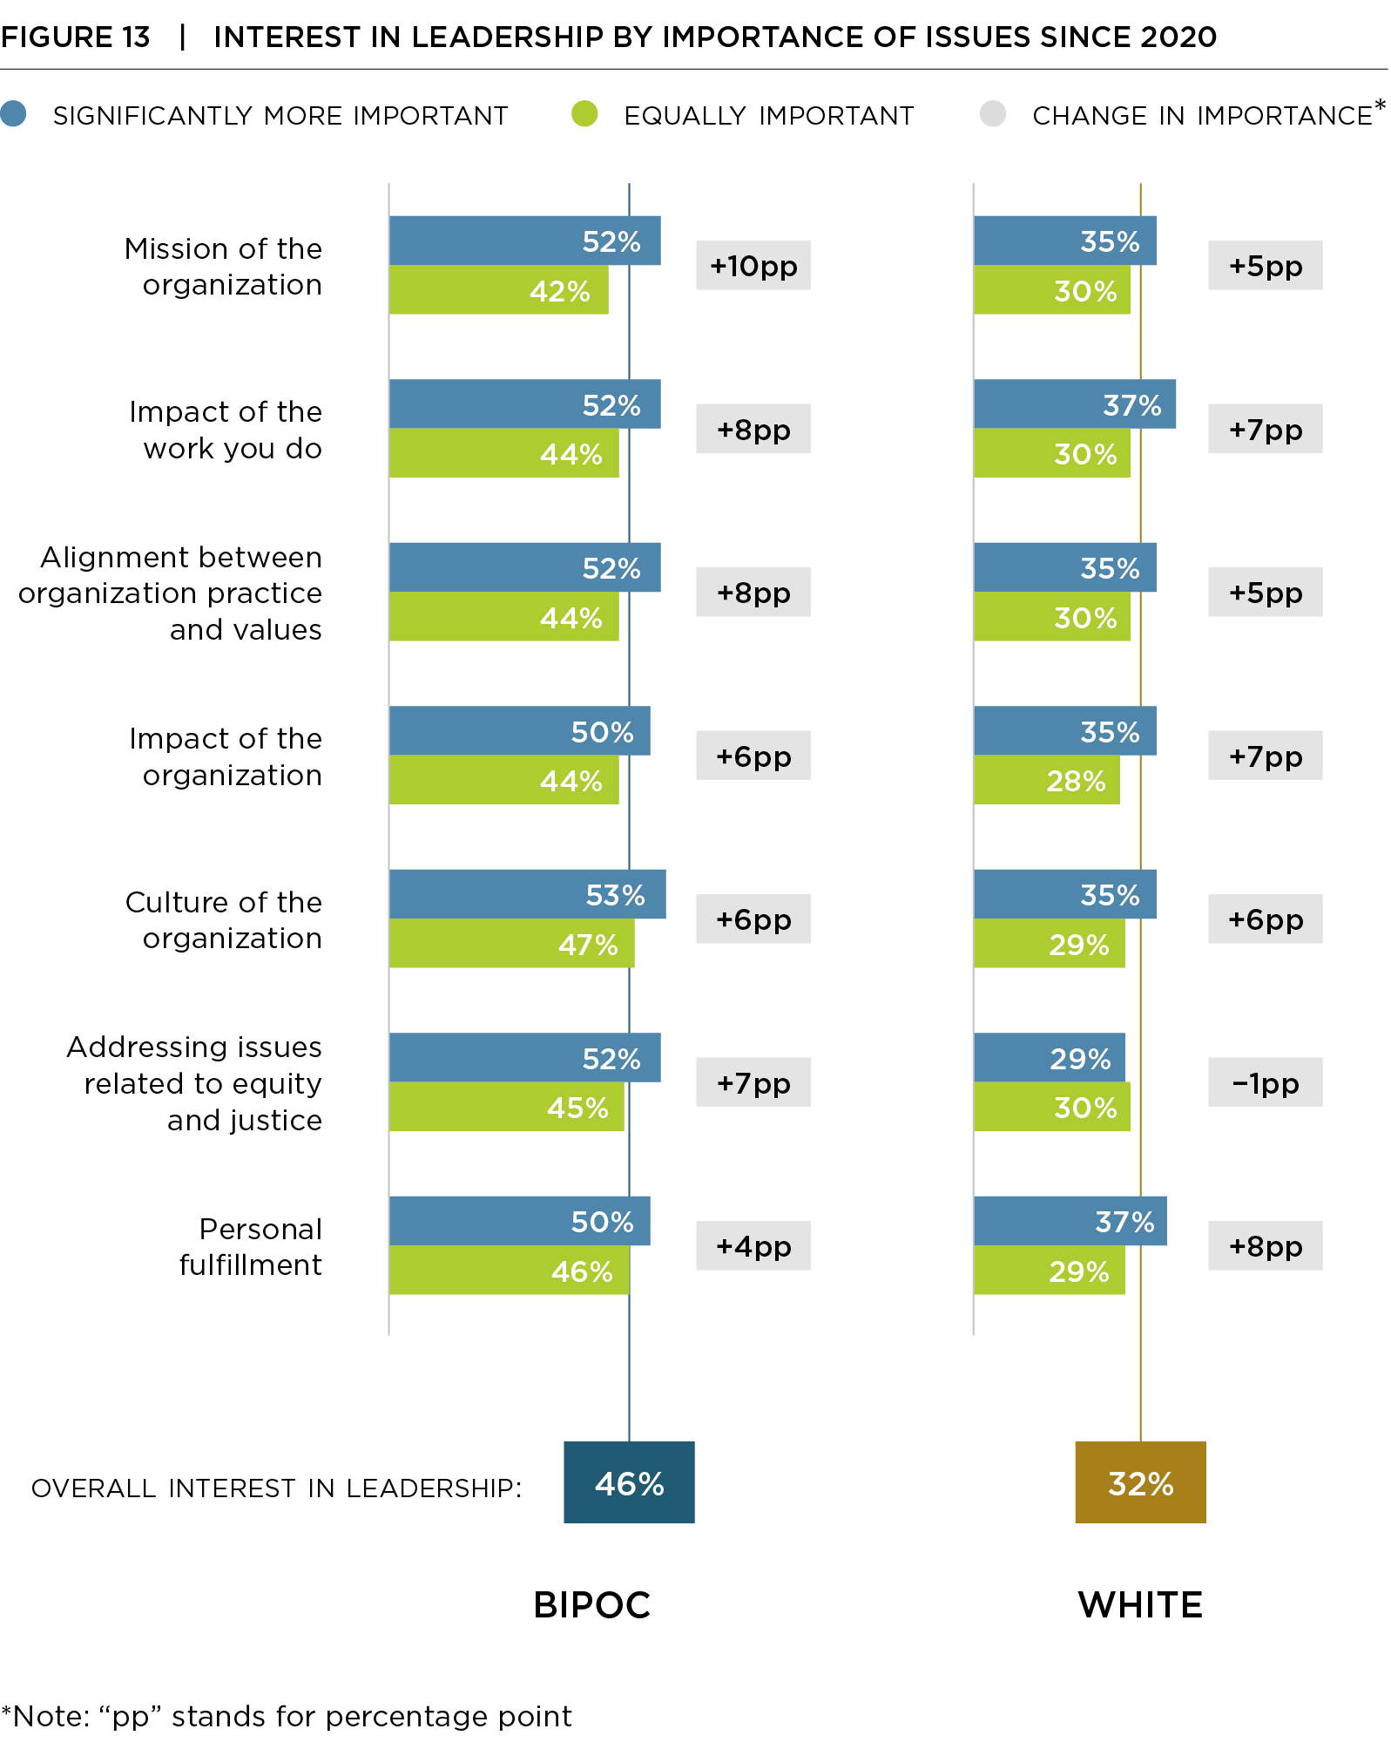
Post-2020 Priorities that may Boost Interest
Notes:
This shows the interest in leadership based on whether they said something was more or equally important since 2020.

Slide 29
Potential Priorities to Boost Interest (alternate layout)

Slide 30
What Is Needed
A doable job including the funds to hire staff that can help address internal structures and external threats.
Openness to new leadership models ranging from co-directors to stronger board/leader partnerships. Our data found that co-directorships are on the rise, an indication that sharing the leadership is a new way of supporting those in the top role.
Interventions and programs that are adequately resourced to support cohorts of current and future leaders and demonstrate the benefits of networks and impacts of leadership.

Slide 31
Poll?
Another topic as break before panel?

Slide 32
Panel

Slide 33
Add slide with headshot and name for each panelist

